Slide 1
NinjaProtected+
Sizing a StoreOnce with the HPE Storage Assessment Foundry NinjaProtected+ (Backup Assessment) Module
Mitchell Mikula - August 2018

Slide 3
NinjaProtected+ is part of the Storage Assessment Foundry
What is SAF?
SAF is an HPE developed suite of inter-related applications for use in analysis and sizing
SAF collects critical metrics from multiple different workload types, not just storage
SAF performs analysis of the collected metrics to define sizing requirements
Allows drill-down analysis of the collected metrics to validate sizing objectives
What’s in it for me?
Quickly collect information about a customers existing workloads and from unfamiliar devices
Collaborative working and Peer review of collected metrics and analysis output
Rapid summary of key metrics required as input to various sizers

Slide 4
SAF Vision
End to End Assessment / Sizing / Quoting
Collect
Analyse
Build/Size
Propose & Quote
SAF Collector &
Multiple Data Sources
Servers, Storage Arrays, BURA, Applications
Automated Data Collection
‘Lightweight’ Collector
Desktop ‘Controller’
Manual Option for Dark Sites
Roadmap:
Customer DIY data collection
SAF Online Application
Data Analysis
Report Generation
Turns data into sizing goals & objectives
Deep analysis of collected data
Collaborative working features
Roadmap:
Additional data sources
Additional analysis reports
Deep Analysis of combined data sources
Tight integration with NinjaSTARS, StoreVista, NinjaProtected+, NinjaCrawler, DDAnalyse and more
NinjaSTARS
Wizard based sizing with configuration objectives derived from SAF analysis
Capacity
Performance
SLA
Roadmap:
Upgrade Planner (Import of existing 3PAR configuration to ease HW upgrades configuration)
Competitive Replacement
Integration with OCA*
OCA*
3PAR configuration bill of materials exported from NinjaSTARS to OCA
Validation
Legal/Budgetary quote
Improved average lead time
Enhanced end user experience
*ETA currently undefined

Slide 5
Storage Assessment Foundry
⬅⬅⬅⬅⬅⬅ Remember this!!!
https://saf.itcs.hpe.com

Slide 6
Storage Assessment Foundry
https://saf.itcs.hpe.com
Notes:
The SAF Collect Tile is where you get the Collector scripts for NPP
The NinjaProtected+ tile is where you can find complete information about NPP.

Slide 7
SAF Modules
SAF Module | Description
SAF Collect | Utility used to collect data at a customer’s site.
SAF Analyse | Analyse workloads and provides key metrics for sizers.
NinjaSTARS | Sizing tool for 3PAR and Nimble (and soon StoreOnce)
Scality Sizer | Web based sizer for Scality Object Storage
Report Requestor | Generate reports for 3PAR arrays
NinjaCrawler | Calculate exact dedupe and compression ratio of customer data
NinjaProtected+ | Analyse Backup configuration and performance, propose StoreOnce
DD Analyser | Analyse EMC Data Domain, propose StoreOnce
Other Tools | A collection of legacy sizing related tools not directly developed by the SAF team.
Notes:
Backup Analysis: SAF NPP supports more products than MiTrend

Slide 8
Storage Assessment Foundry
https://saf.itcs.hpe.com

Slide 9
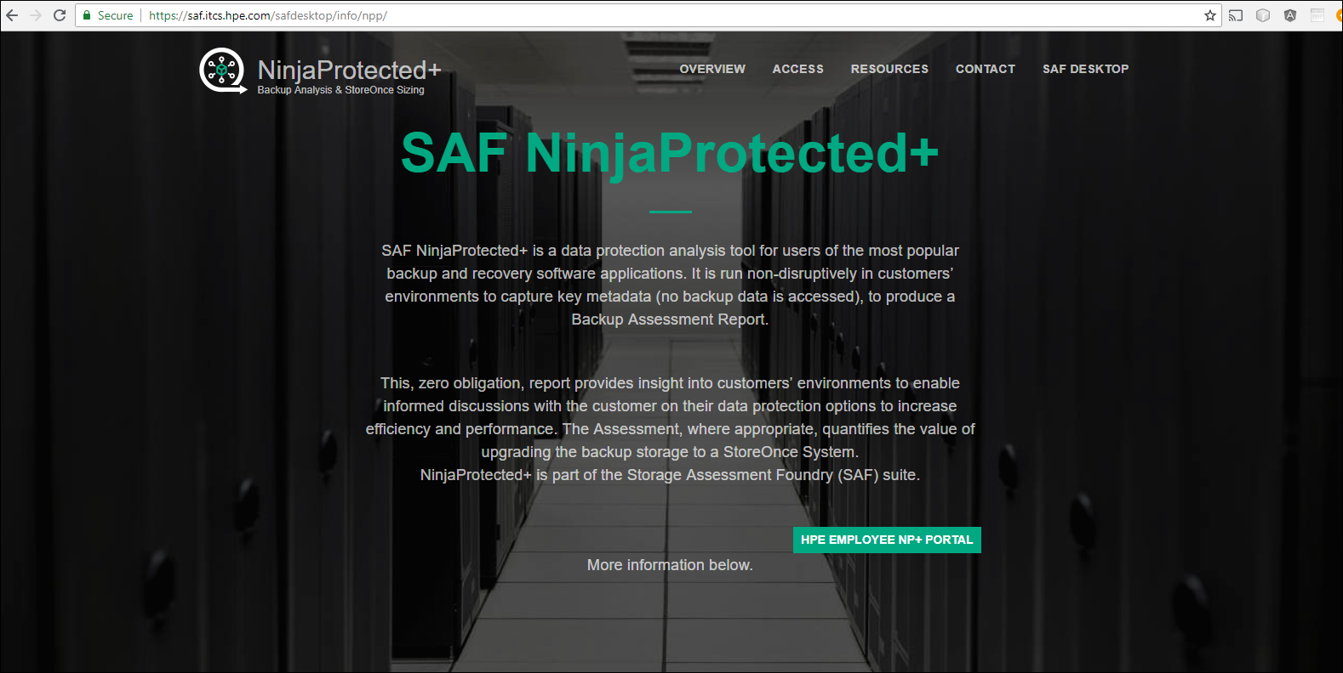
NinjaProtected+ page on the SAF portal
Notes:
When you click the NinjaProtected+ tile on the SAF Desktop, you go to a page with information about how to do an NPP assessment, as well as sample reports and presentations.

Slide 10
SAF Collect
Workloads | Performance | Capacity | Configuration | Backup | Versions
HPE 3PAR StoreServ | Yes | Yes | Yes |  | 3.2.2 and newer (requires WSAPI 1.5)
EMC VMAX | Yes | Yes | Yes
EMC VNX | Yes | Yes | Yes
PURE Storage | Yes | Yes | Yes
NetApp | Yes | Yes | Yes |  | In beta
EMC XtremIO | Yes | Yes | Yes |  | In beta
IBM XiV | Yes | Yes | Yes |  | In beta
Windows Hosts | Yes | Yes | Yes
Linux Hosts | Yes | Yes | Yes
Vmware (RVTools) |  | Yes | Yes
Vmware | Yes | Yes | Yes |  | In beta
Brocade SAN Switch |  |  | Yes
Veritas NetBackup |  |  | Yes | Yes | 6.5 – 8.1
Veritas NetBackup Appliance |  |  | Yes | Yes | 2.6.x, 2.7.x, & 3.0
Veritas BackupExec |  |  | Yes | Yes | BE2012 (14.0), BE2014, BE15, BE16, & BE20
MicroFocus Data Protector |  |  | Yes | Yes | 6.11 – 10.02
IBM Spectrum Protect (TSM) |  |  | Yes | Yes | 6.1 – 7.1.x
CommVault |  |  | Yes | Yes | 10 – 11
Veeam |  |  | Yes | Yes | 9.0 – 9.5
DELL|EMC NetWorker |  |  | Yes | Yes | 8.0 – 8.2
Notes:
The SAF Collector can collect data from a large number of sources. The circled items are the NPP collection scripts. The SAF Collector does NOT run the collectors on the backup server, rather it writes the scripts into a local directory.

Slide 11
NinjaProtected+
What is it?
An enterprise backup environment discovery and assessment tool.
It collects backup environment meta-data from a customer site, generates reports on customer backup analytics, suggested sales opportunities, and provides storage sizing information.
Point toward sales opportunities (StoreOnce and RMC)
Spark customer discussion about their backups and existing storage
Allow an automated storage sizing/solution for a StoreOnce environment
Allow SAF to build a dataset to better understand industry, regional, and ISV patterns.

Slide 12
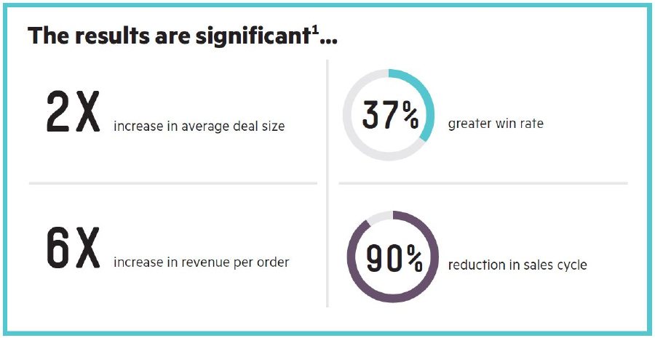
Benefit of using NPP for StoreOnce Deals
Notes:
Not sure if you should run an NPP Backup assessment? Take a close look at the numbers on this page.

Slide 13
NinjaProtected+ Process (HPE Employees)
1
Login to the SAF portal and download the SAF Collector
2
Run the SAF Collector to extract the backup collector scripts
3
Run the collector script on the Customer’s Backups Server
4
Upload the zip file (or DB dump) to the NP+ self service site
5
Download or generate On-demand Reports
6
Use the import option on the HPE Storage Sizing Tool

Slide 14
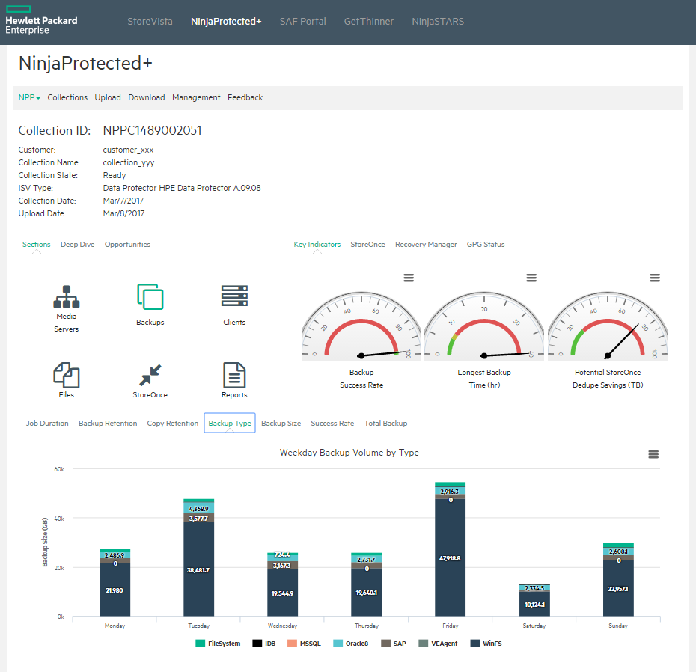
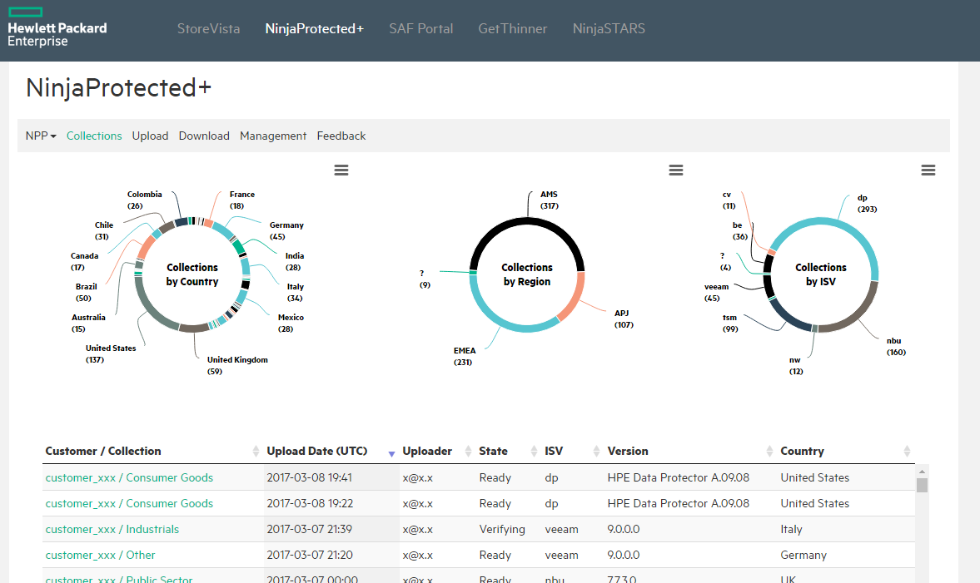
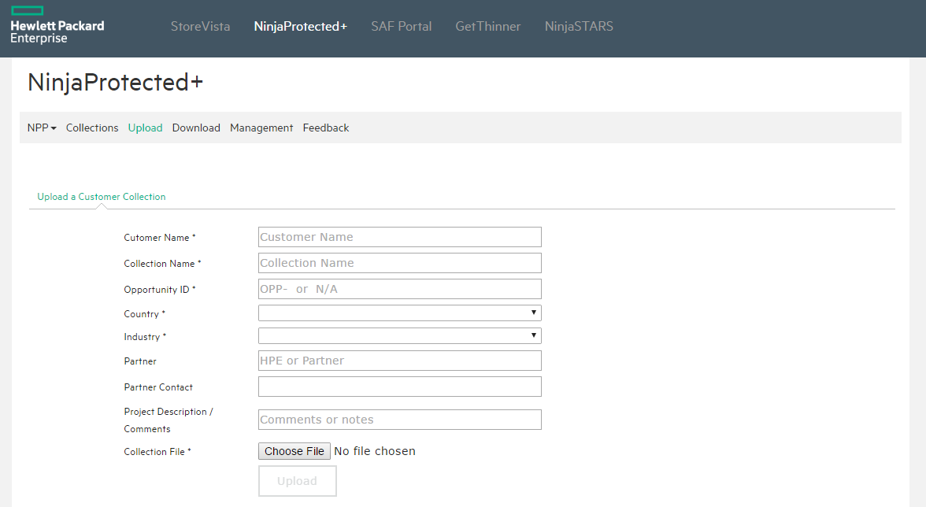
NinjaProtected+ Management GUI (HPE Employees Only)
Notes:
This self service portal can be found via the NinjaProtected+ tile on the SAF desktop.

Slide 15
NinjaProtected+ Process (Partners)
1
Send email to support: ninjaprotected@hpe.com
2
Provide Customer information
3
Download the SAF Collector and extract the scripts
4
Run the collector script on a customer’s backups server
5
Work with support to upload the zip file (or DB dump)
6
Receive generated reports via email
7
Use the import option on the HPE Storage Sizing Tool

Slide 16
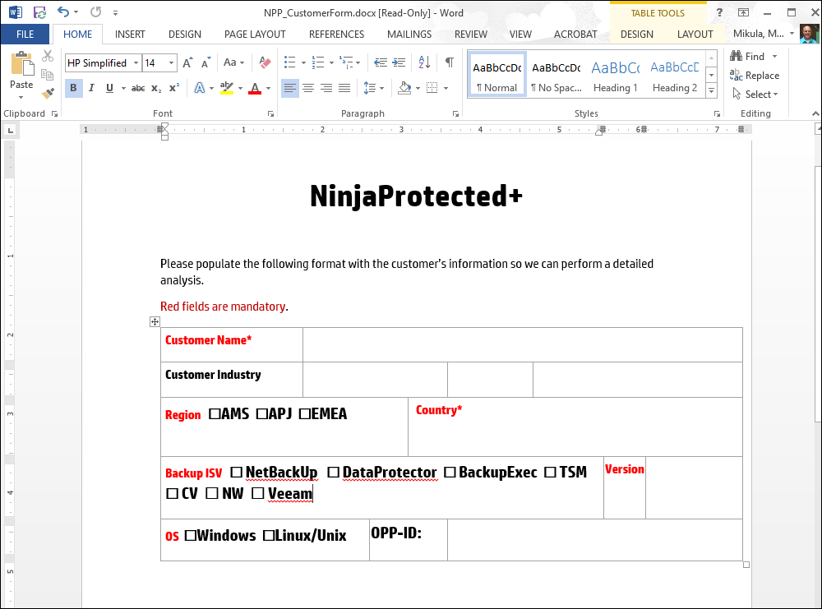
Customer Information Required by NPP Support
Receive via email from support
Or
Download from SAF Portal or Partner Portal
Return to support (ninjaprotected@hpe.com)

Slide 17
Running the SAF Collector to extract the NinjaProtected+ Scripts
C:\Users\test\Documents\tmp\SAFCOL>SAFcollector.exe BackupISVs –All
Executing BackupISVs (Create scripts and User Guide for backup environment data collection [NinjaProtected+]):
BackupISVs - Create scripts and User Guide for backup environment data collection...
Finished: scripts and User Guide for backup environment data collection are available from
C:\Users\test\Documents\tmp\SAFCOL\BackupISVs ...
C:\Users\test\Documents\tmp\SAFCOL>cd BackupISV
C:\Users\test\Documents\tmp\SAFCOL\BackupISVs>dir
Directory of C:\Users\test\Documents\tmp\SAFCOL\BackupISVs
08/08/2018 03:16 PM <DIR> .
08/08/2018 03:16 PM <DIR> ..
08/08/2018 03:16 PM <DIR> BackupExec
08/08/2018 03:16 PM <DIR> Commvault
08/08/2018 03:16 PM <DIR> DataProtector
08/08/2018 03:16 PM 2,094,382 hpe_npp_collector_userguide.pdf
08/08/2018 03:16 PM <DIR> NetBackup
08/08/2018 03:16 PM <DIR> NetWorker
08/08/2018 03:16 PM <DIR> TSM
08/08/2018 03:16 PM <DIR> Veeam

Slide 18
Collector Scripts
We understand that customers are very protective of backup servers
The collectors are simple scripts
Nothing to install
They run and complete in about 10 minutes
Easy to examine by the customer
BackupExec, Commvault, and Veeam have the option of submitting a copy of the SQL Database.
Because a small configuration change to SQL Server is required in order to allow scripts to connect, 95% of NPP assessments for BE, CV, and Veeam are down via a Database backup.
The User guide has step-by-step instructions for the required SQL Server configuration change and for backing up the database.

Slide 19
Return the file (zip or DB backup) to HPE
The zip file from a collection script can range in size from a few 100 KBs to a few 100 MBs
SQL Database backups can range from a 10s of MB to a couple GB.
Options for uploading the file are:
Email smaller files directly to ninjaprotected@hpe.com
Request ftp site information from the support team
Request a dropbox link from the support team

Slide 20
NinjaProtected+ Deliverables
Deliverable | Target Audience
Executive Report | Customers
Recovery Manager Central Report | Customers
Detailed Report | Partners | Sales Team
XML/CSV Storage Sizing Report (for use with Storage Sizer) | Partners | Sales Team
Workshop material & Report ‘Instruction Sheets’ | Partners | Sales Team
Notes:
All these respective collaterals are now available on the WW Storage Sales Portal:
Link : http://www8.hp.com/us/en/products/data-storage/3par-thinner.html.
And Partner Portal, Link : https://partner.hpe.com/

Slide 21
Executive Report
15 page report intended for the customer
This is one of the primary incentives for a customer to allow you to run the collectors
Contains:
Stats and information about the backup environment
StoreOnce and RMC positioning information
Get Protected Guarantee program status

Slide 22
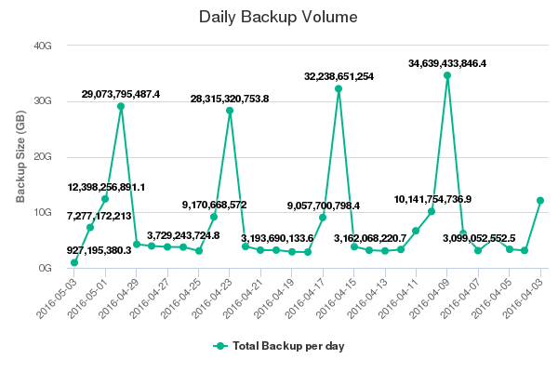
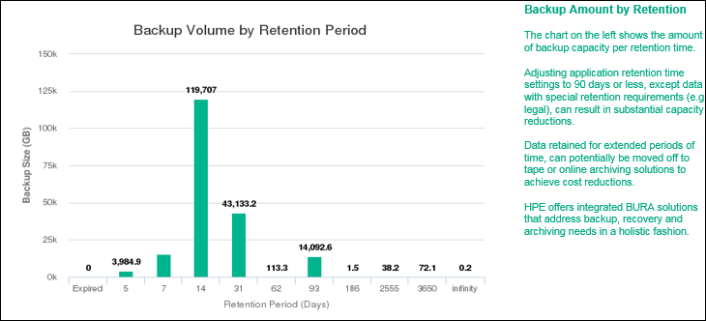
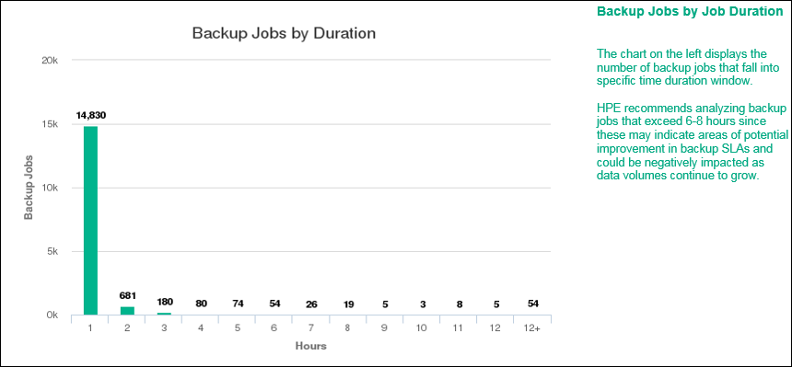
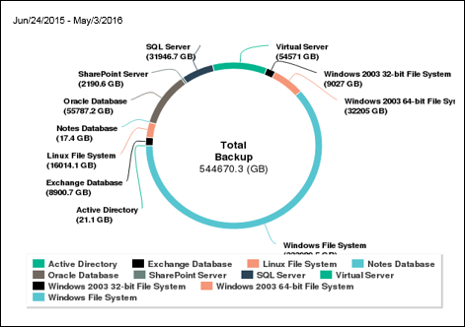
Executive Report
Notes:
Statistics from the Backup environment.

Slide 23
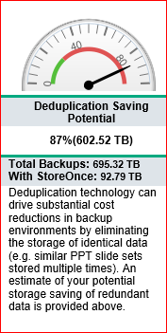
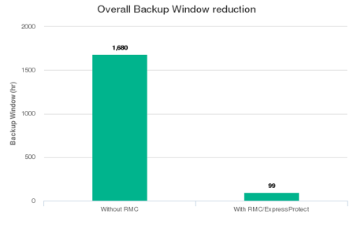
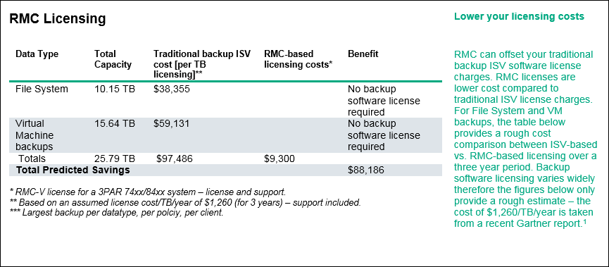
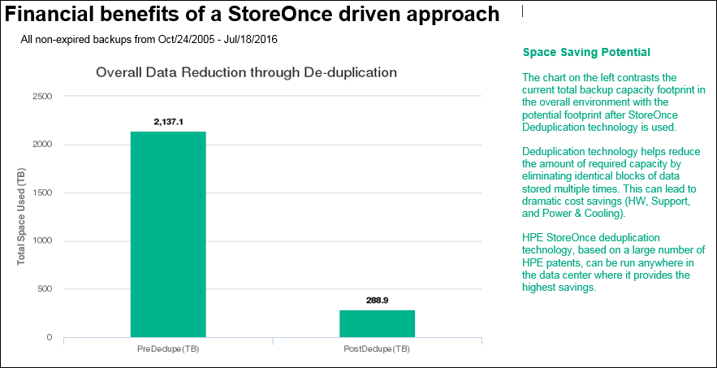
Executive Report
Notes:
Positioning for the value of a StoreOnce. Notice the gauge on the front page. This customer would expect to see 600TB of storage savings by moving to a StoreOnce.

Slide 24
Get Protected Guarantee Program
Reduce capacity requirements by 95% with any HPE StoreOnce System… Guaranteed!*
Details
Applies to any new HPE StoreOnce System including StoreOnce VSA
Data types include file servers, MS Exchange, and virtual machines (using agentless backup methods)
Audio and video files cannot exceed 10% of the total data within a backup
If the guarantee is not met, HPE will make up the difference with additional capacity and support
Deployment requirements
Backup applications supported include:
- HPE Data Protector
- Veritas NetBackup
Daily and weekly full backups for at least 90 days required for 95% guarantee
Daily incremental backups and weekly full backups for at least 90 days can qualify for a 90% guarantee
HPE NinjaProtected + tool will be run before and after installation to determine if guarantee was met
Program information available at: GetProtectedGuarantee web site
HPE Confidential – for HPE and Channel Partner Use Only
Notes:
Here are some of the details of the GPG program. All program details are outlined on the linked website.

Slide 25
Executive Report – GPG Page
For NetBackup and Data Protector, the last page of the Executive Report is a Get protected Guarantee status page.

Slide 26
RMC TCO Report
5 page report intended for the customer
Contains:
RMC positioning
These pages are also in the Executive Report, but are made into a standalone report here

Slide 27
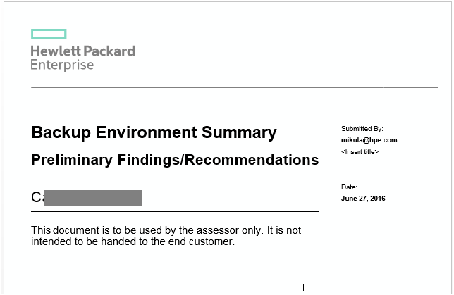
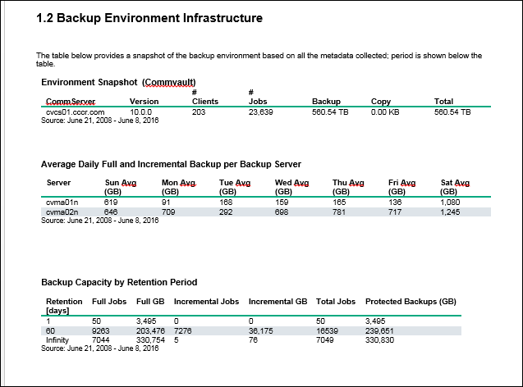
Detailed Report
10-30 page report intended for BURA folks
Contains:
A variety of charts, and tables and Stats and information about the backup environment
Intended as background information for the sales/pre-sales teams

Slide 28
Using the HPE Storage Sizer Input files
On the HPE Storage Sizer, on the Backup Calculator tab, use the Import Data from Ninja Protected Tool

Slide 29
HPE Storage Sizer Input files
The Solve button is used to generate a correct StoreOnce configuration
Notes:
After loading the XML file from NinjaProtected+, BEFORE you hit the “Solve / Submit” button, you need to talk with the customer to see how they would use the StoreOnce. It’s rare that a customer would put a StoreOnce into an environment and move all existing backups onto it without changing things. Perhaps that are only going to put Oracle backups on the StoreOnce, or perhaps they want to retain more copies.
Before hitting the solve button, account for yearly growth and adjust the policies.

Slide 30
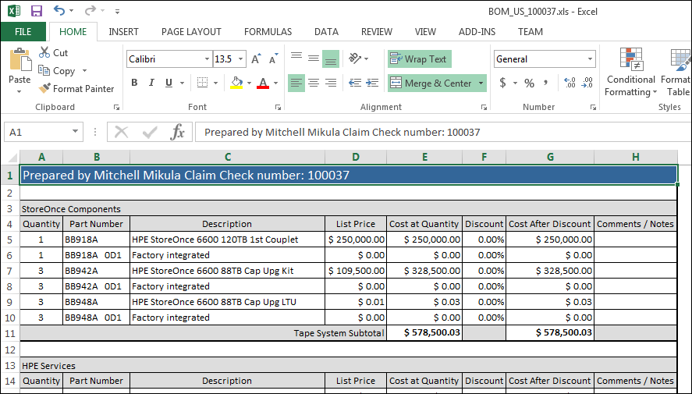
HPE Storage Sizer Output

Slide 31
NinjaProtected+ Support Matrix
Backup ISV | Supported versions | Executive Report | RMC TCO report | Detailed (RFP/Sizing) Report | HPE Storage Sizer files
Data Protector | A.06.11 - A.10.0.2 | ü | ü | ü | ü
Veritas NetBackup NetBackup Appliance | 6.5 – 8.1 2.6.x, 2.7.x, 3.0 | ü | ü | ü | ü
Veritas BackupExec | BE2012 (14.0), BE2014, BE15, BE16, & BE20 | ü |  | ü | ü
IBM Spectrum Protect (TSM) | 6.1 – 7.1.x | ü | ü | ü
Commvault | 10-11 | ü | ü | ü | ü
Veeam | 9.0 – 9.5 | ü | ü | ü | ü
Dell EMC Networker | 8.0-8.2 | ü | ü | ü | ü

Slide 32
NinjaProtected+ Roadmap
Ongoing ISV new versions
Upload/Analysis/Reporting integration with SAF Analyse
Self-Serve upload/Reports for Partners
Integration with NinjaSTARS
NinjaSTARS is adding a complete StoreOnce Sizing component near the end of the year.

Slide 33
SAF NinjaProtected+ URLs
Storage Assessment Foundry
https://saf.itcs.hpe.com
Main NinjaProtected+ URL (HPE Internal)
http://npp.storevista.hpecorp.net
Partner Ready Portal
https://partner.hpe.com/login

Slide 34
Q & A

